Slide 1
Microsoft Excel 2011
Chapter 1
Creating a Worksheet and an Embedded Chart

Slide 2
Objectives
Enter text and numbers
Use the Sum button to sum a range of cells
Create a chart
Preview and print a worksheet

Slide 3
Project – Working with an Embedded Chart

Slide 4
General Project Guidelines
Select titles for the worksheet
Determine the contents for rows and columns
Determine the calculations that are needed
Determine where to save the workbook
Decide on the type of chart needed
Establish where to position and how to format the chart

Slide 5
Entering the Worksheet Title
Click cell A1 to make cell A1 the active cell
Type the worksheet title in cell A1 and then click the Enter button in the formula bar to complete the entry and enter a worksheet title

Slide 6
Entering Column Titles
Click the cell to place the first column title
Type the column title
Press the RIGHT ARROW key to enter a column title and make the cell to the right the active cell
Repeat the previous two steps until all column titles are entered. Click the Enter button after entering the last column title

Slide 7
Entering Column Titles

Slide 8
Entering Row Titles
Click the cell to place the first row title
Type the row title
Press the DOWN ARROW key to enter a row title and make the cell below the current cell the active cell
Repeat the previous two steps until all row titles are entered. Press the RETURN key after entering the last row title

Slide 9
Entering Row Titles

Slide 10
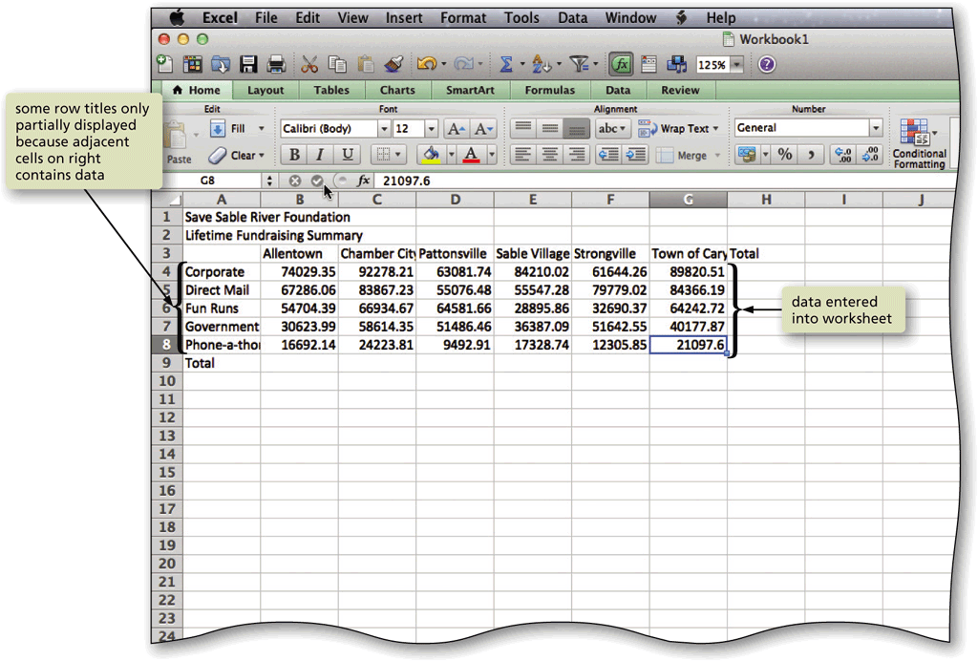
Entering Numbers
In Excel, you can enter numbers in Excel to represent amounts
If a cell entry contains any other keyboard character, Excel interprets it as text and treats it accordingly

Slide 11
Summing a Row of Numbers
Click the first empty cell to the right of the numbers to sum
Click the AutoSum button in the Standard toolbar to display a formula in the formula bar and in the active cell – make sure the cells you want to total are selected
Click the Enter button in the formula bar to enter a sum in the active cell

Slide 12
Summing a Column of Numbers

Slide 13
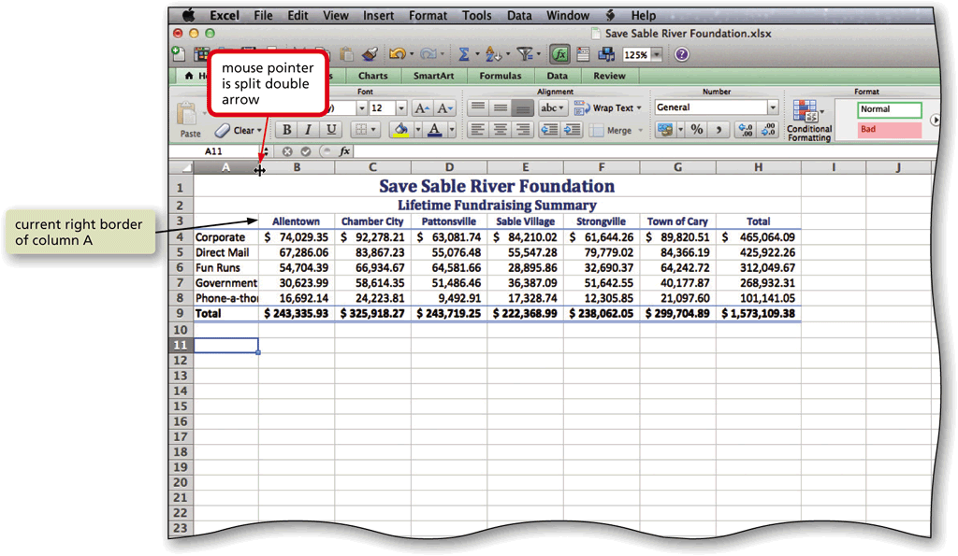
Adjusting the Column Width
Point to the boundary on the right side of the column of which you want to change the size to change the mouse pointer to a split double arrow
Double-click on the boundary to adjust the width of the column to the width of the largest item in the column

Slide 14
Adding a Chart to the Worksheet
Select the range to be charted
Click Charts on the ribbon to display the Charts tab
On the Charts tab, under Insert Chart, click the Column button to display the Column gallery
Click the Clustered Cylinder chart type in the Cylinder area of the Column gallery to add the selected chart type to the middle of the worksheet in a selection rectangle

Slide 15
Adding a Clustered Cylinder Chart to the Worksheet
Drag the sizing handles to resize the chart
On the Charts tab, under Chart Styles, click the More button to display the Chart Styles gallery
Click the desired style in the Chart Styles gallery to apply the chart style to the chart

Slide 16
Adding a Clustered Cylinder Chart to the Worksheet

Slide 17
Previewing and Printing a Worksheet in Landscape Orientation
Click File in the menu bar to display the File menu
Choose Print to display the Print dialog
Verify the printer name that appears in the Printer box will print a hard copy of the document. If necessary, click the Printer box to display a list of available printer options and then choose the desired printer to change the currently selected printer
If necessary, click the Show Quick Preview check box to select this option
Click the Page Setup button in the Print dialog to open the Page Setup dialog
On the Page tab, under Orientation, select Landscape

Slide 18
Previewing and Printing a Worksheet in Landscape Orientation
Click OK to close the Page Setup dialog
Click the Print button in the Print dialog to print the document on the currently selected printer
When the printer stops, retrieve the hard copy

Slide 19
Previewing and Printing a Worksheet in Landscape Orientation

Slide 20
Chapter Summary
Describe the Excel worksheet
Enter text and numbers
Use the Sum button to sum a range of cells
Create a chart
Change a worksheet name and worksheet tab color
Preview and print a worksheet

Slide 21
Microsoft Excel 2011
Chapter 1 Complete

