Slide 1
Digital Citizenship

Slide 2
9 elements of Digital Citizenship
Digital Access: full electronic participation in society.
Digital Commerce: electronic buying and selling of goods.
Digital Communication: electronic exchange of information.
Digital Etiquette: electronic standards of conduct or procedure.
Digital Literacy: process of teaching and learning about technology and the use of technology.
Digital Law: electronic responsibility for actions and deeds
Digital Rights & Responsibilities: those freedoms extended to everyone in a digital world.
Digital Health & Wellness: physical and psychological well-being in a digital technology world.
Digital Security (self-protection): electronic precautions to guarantee safety.

Slide 3
Digital Etiquette
Using technology in a way that doesn't affect others negatively
Using technology only when it is appropriate
Respecting others online by not posting information that is hurtful or untrue.
Whenever you work and communicate online, there are some basic rules you should follow…

Slide 4
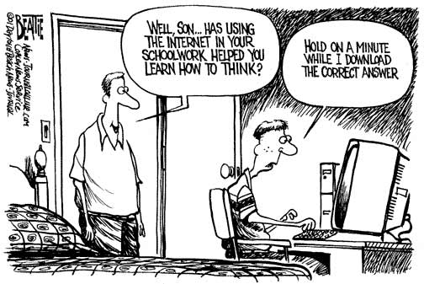

Slide 5
Digital Literacy
Learning about the basics of using a computer
Evaluating online resources to make sure they are truthful, reliable and accurate
Is the site authoritative?
Evaluating a Web Site
Learning how to find information on a specific topic on the Internet
How to search Better
Cheat Sheet

Slide 6
Criteria for Determining Reliability/Authority of a Web Site
Purpose: What is the purpose of the site? | commercial informative or educational entertainment personal a hoax
Author's Intent | What is the top-level domain of the site? Who created the site and what authority do they have on the subject? What contact information is given for the author or sponsors?
Bias | Does the content give only one side of an issue? If so, do they hide their bias? Does their bias impact the usefulness of the information?
Content | Is the site accurate, complete, well-written, and relevant? Is the site up-to-date? Do most of the links on the page lead to relevant information? Are there mistakes in spelling or word usage?
back

Slide 7
Think before you send.
If you send an email or post a message in anger, it could come back to haunt you later. The same goes for pictures and videos you post online. Even when something is deleted from a page, it may still be out there waiting to be found when you least expect it.
Respect the time and bandwidth of others.
Don't pass along emails that contain hoaxes, or send messages to the entire student body. The same goes for sending large videos or attachments in an email message. It wastes everyone's time when they have to wade through extra information to get to the important stuff.
Don't send messages that could be misinterpreted as threatening or hurtful.
Be careful about the language you use as well as the information you pass along about others. Sending messages that could be seen as threatening may result in disciplinary action.
Follow the conventions of writing when sending formal emails or posting comments online.
Unless the message you're sending is informal (such as a text message to a friend), you should use correct spelling, grammar, and punctuation. You shouldn't WRITE IN ALL CAPS! (It's considered shouting)
Respect others' right to privacy.
Don't use technology to pass along rumors or share personal information about someone without their permission. The same goes for posting names and photos of others.
back

